Slide 1
CineFlow
A premium web application bridging theatrical booking and digital rental s.

Slide 2
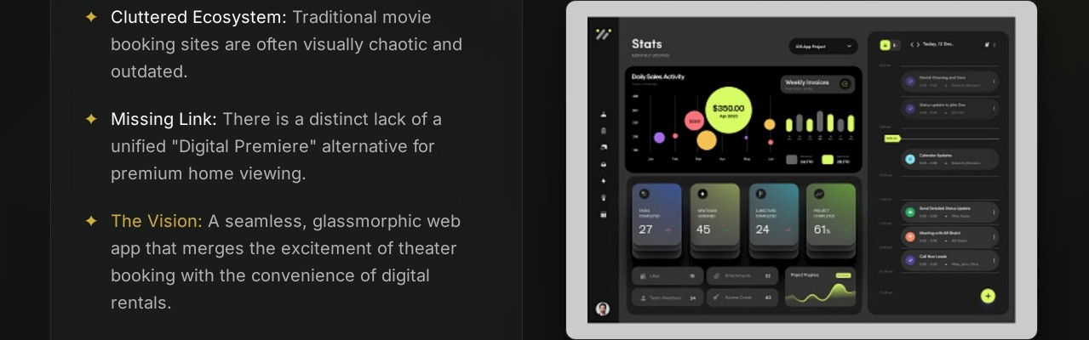
The Entertainment Gap

Slide 3
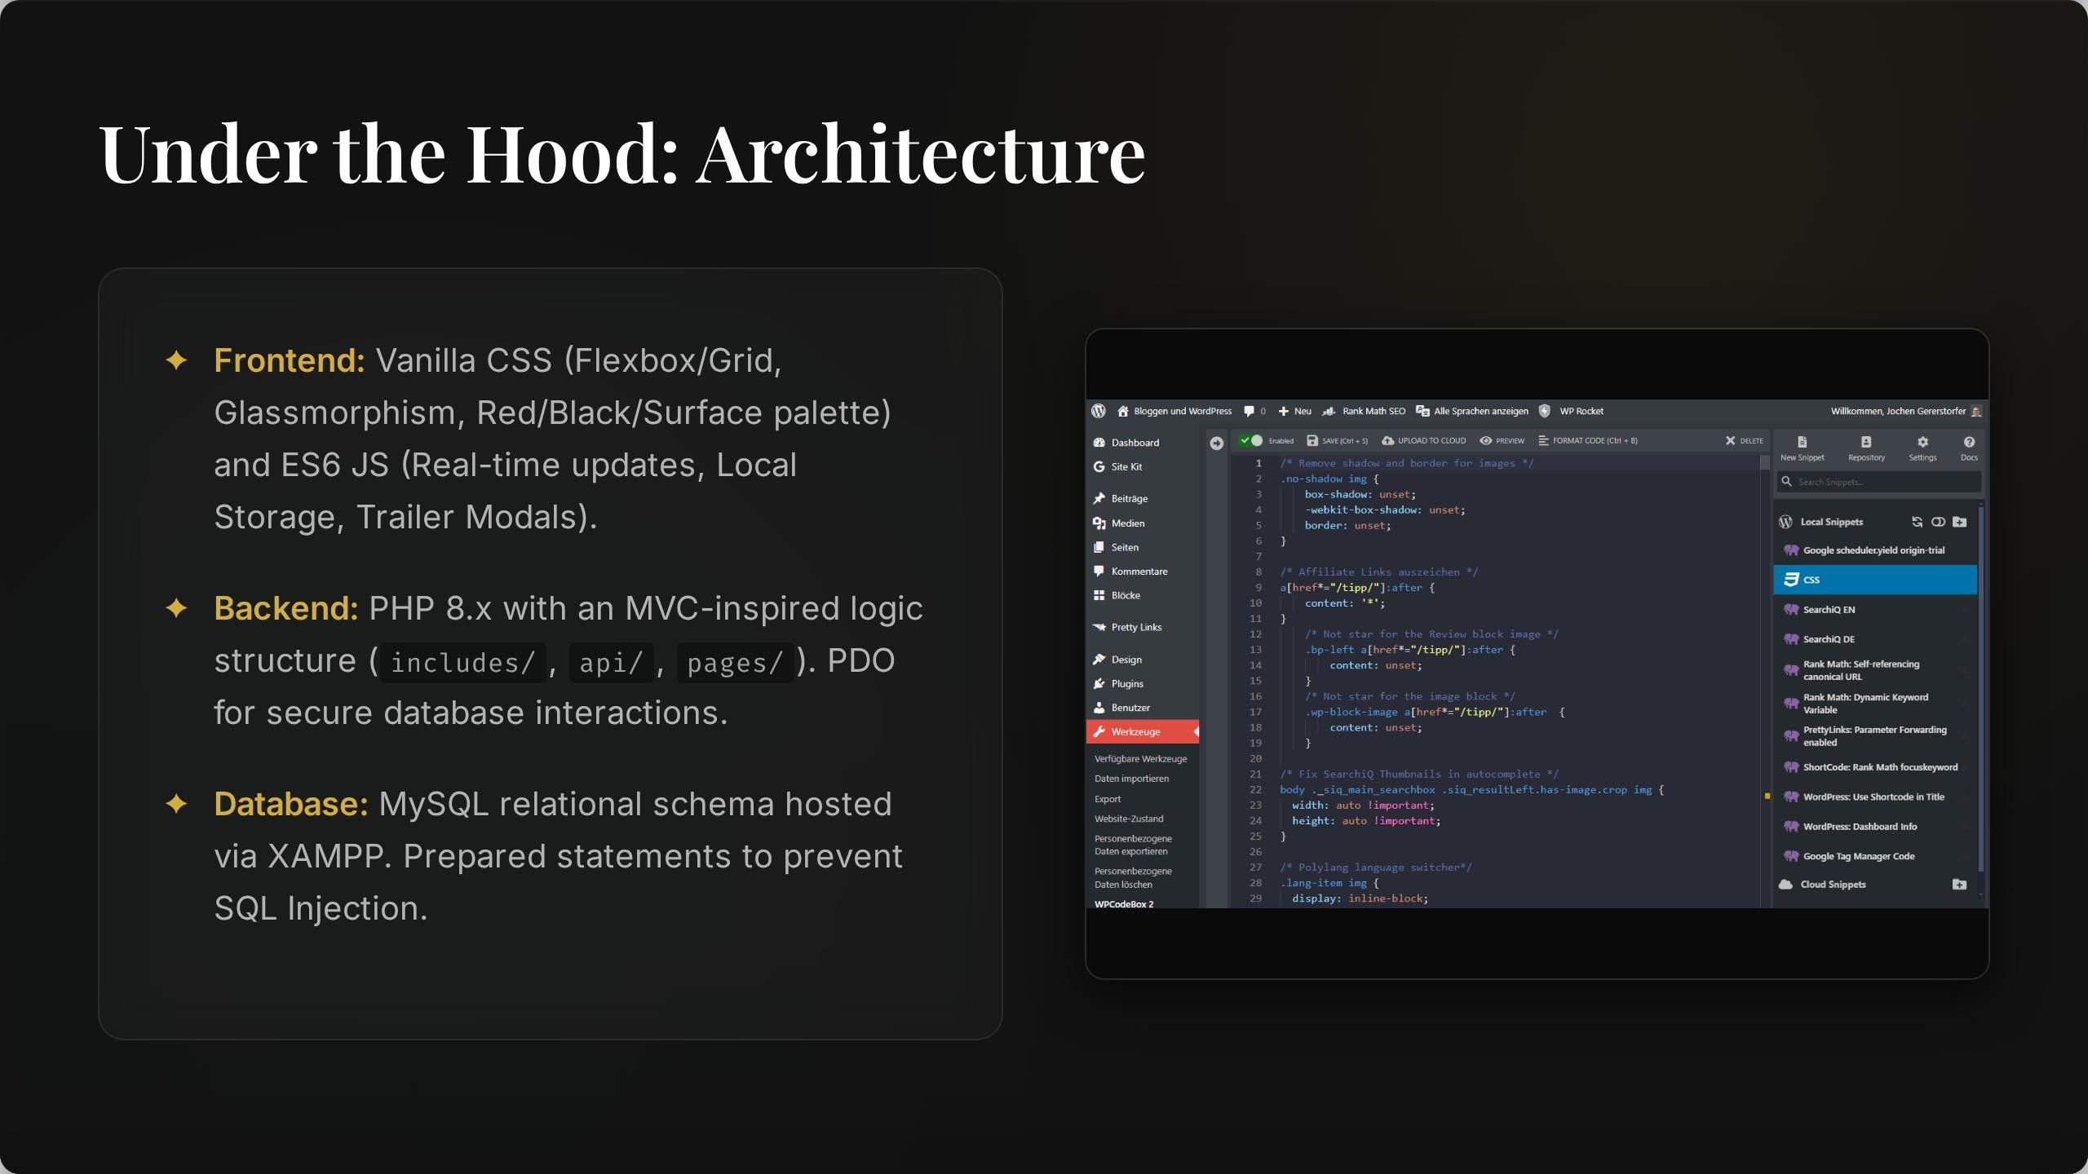

Slide 4













Fortified Access Control
+ Secure Auth: Industry-standard password
hashing using PHP's a s s.‘.o r d lla s ll( )
SMTP OTP System: Powered by Brevo/Gmail VÏä ma it heh p er . pIlp . A 6-dÏÇÏt OTP ÏS required for account verification and secure login.
Recovery Flow: Full tokenized "Forgot Password" sequence to strictly validate user identity before granting access.
Workflow: Request -+ Token Gen -+ SMTP Dispatch -+ Verification

Slide 5
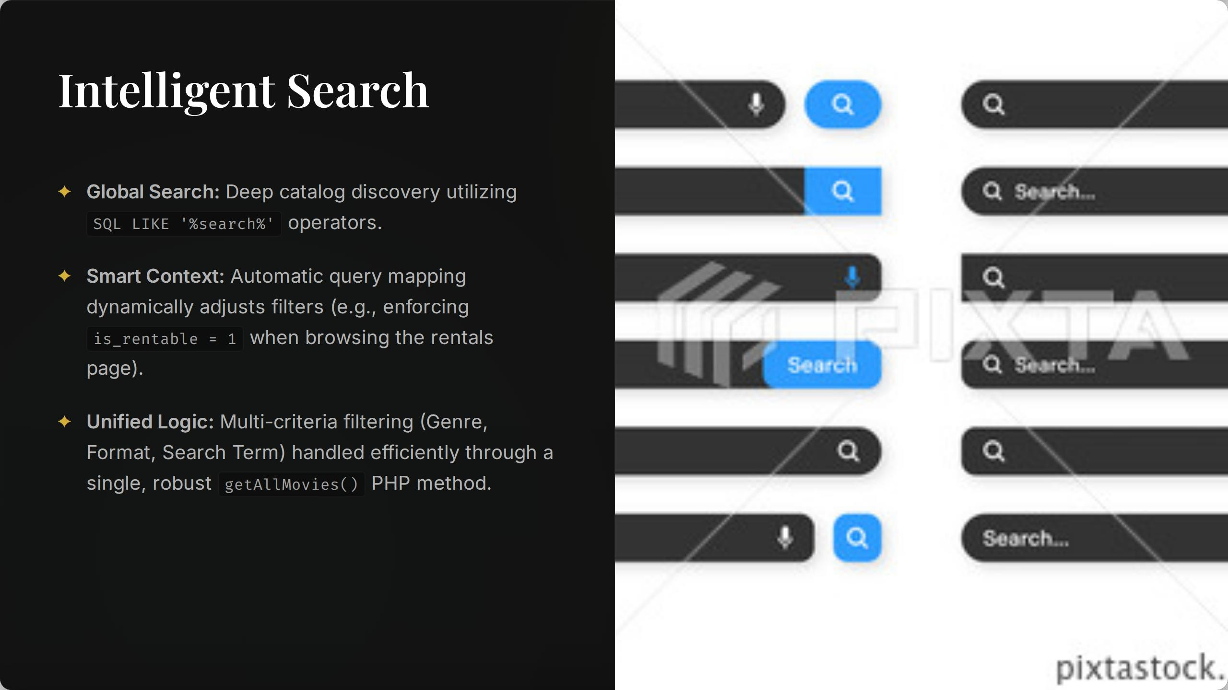

Slide 6
Deterministic Occupancy Simulation
Dynamic Showtimes: Showtime schedules and theater availability are pulled dynamically from the backend sho«s table.
Please Select your Seats NOW!
1 2 3 4 5
6 7 ß S 1 0 11 1 2
Simulation Logic: Utilizes a deterministic seed ( ift s r a nd ( s h o.v i d ) to static ally simulate 30- 70 % capacity, automatically generating authentic "Fast Filling" urgency badges.
C D
E
Ø Seiec!ed Seat
M Rese 'ed Seat
Empt\ Seat
F
Constraint Engine: Booking logic rigorously prevents users from selecting algorithmically reserved seats.

Slide 7
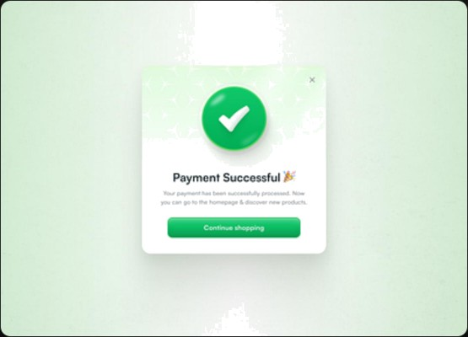
CineFlow Premiere
4 Digital Ownership: A premium secondary marketplace for digital rentals at a Z199 price point.
Data Tracking: The oo v ie r enI a\ s table meticulously monitors purchase time stamps and enforces a strict 48-hour expiration window.
Access Control: Gateway validation ensures onIy active, paid renters can initiate the media player via ma t c h . p h p
Streamlined simulated checkout with instant entitlement validation.

Slide 8



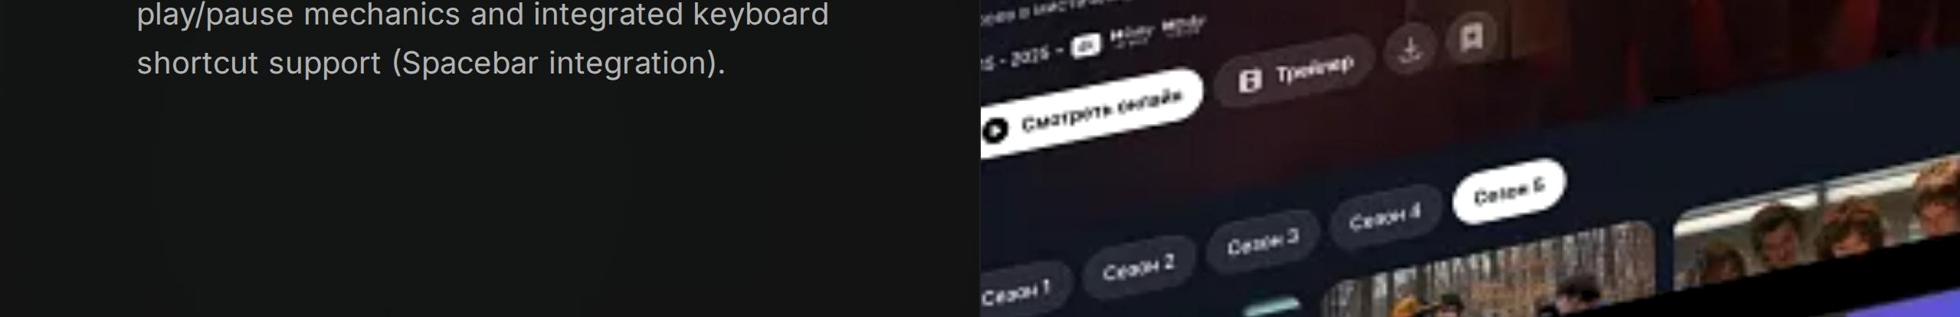
,. -
Hi.gh—F.i.delity Playback
+ The Cinema Player ( watch . php ): HTMLS video player meticulously optimized for high -bitrate
.mp4 streaming and buffering.
+ Dynamic Mapping: PHP securely routes Movie IDs to protected, non -public video assets (e.g., ID 6
BaI man . mp 4 ) .
+ Interactivity: Immersive custom UI overlays for

Slide 9
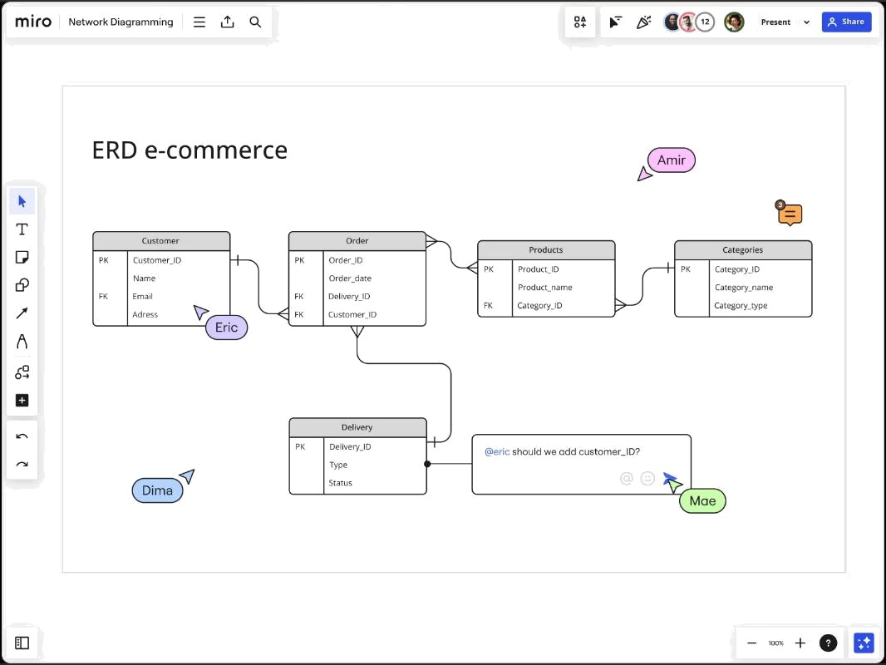
Data Ecosystem
4 users : Profiles, hashed passwords,
verification.
no v ie s : Central catalog (Title, Trailers, Price).
shows : Links movies to theaters, dates, times.
I he aI ers : Venue detail s and seat layouts. bo o l‹I n gs : Theatr ical ticket transactions. mo v ie ren t at s : Digital purchases and
expiration.

Slide 10
Rcady for Scale
4 Database structured and indexed for high -volume transactions.
4 Minimalist CSS/JS ensures lightning-fast load times globally.
+ Built with modern web security and premium UX at its core.

Slide 11
Image Sources

Slide 12
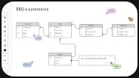
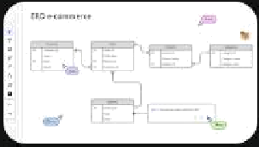
Image Sources

